Slide 1
Microservices in Software Development
Sulthonul Mubarok
CTO at PT Imersa Solusi Teknologi

Slide 2
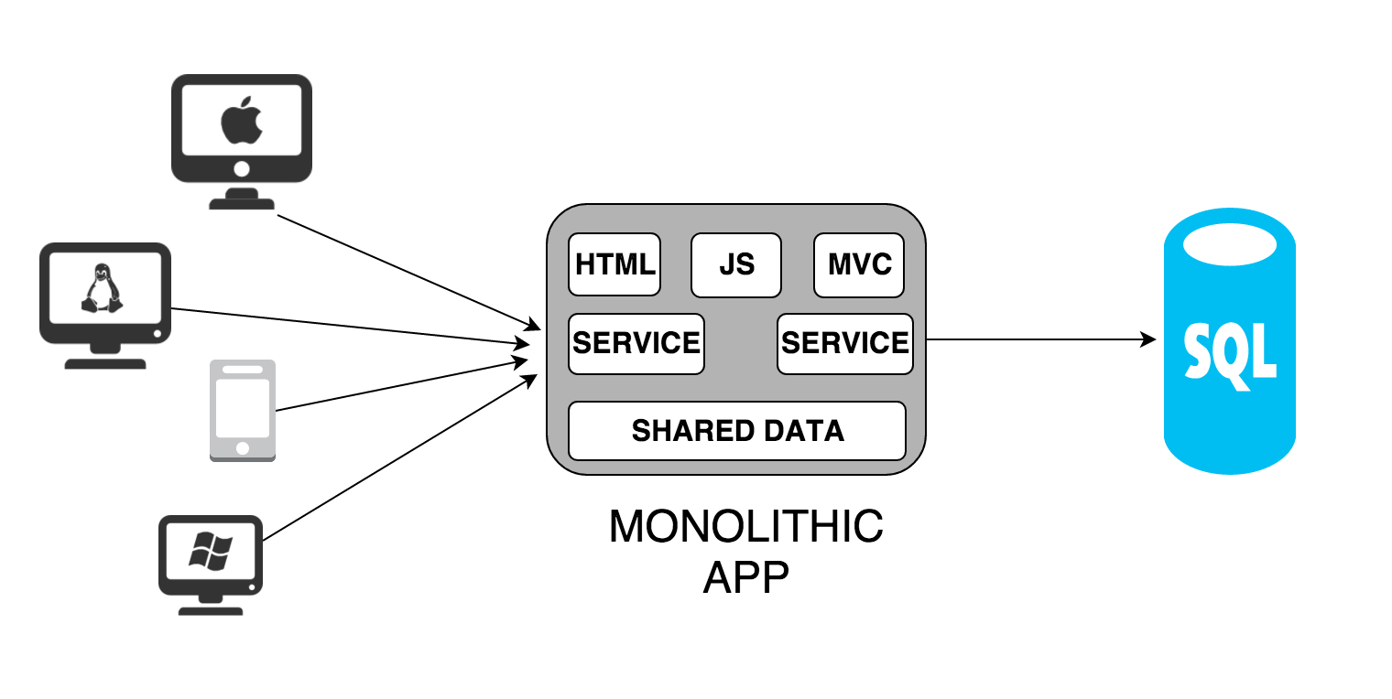
Monolith
Source: https://medium.com/@kiddy.xyz/

Slide 3
Pros and Cons
Easy to build
Easy to test
Easy to deploy to server or cloud

Slide 4
Pros and Cons
When the application becomes large (many have access) the performance will decrease (unless you have more money to pay for a better server LOL)
When will change the technology in the application it will change the whole application.
If an error occurs in one of the functions it will affect the entire application.

Slide 5
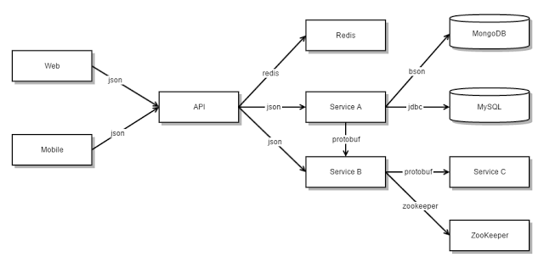
Microservice
Source: https://medium.com/@kiddy.xyz/

Slide 6
Pros and Cons
Scalabale application, secure and reliable
Each service is independent
The maintence is easier
There are no obstacles in using new technology
Each developer team can develop each of its services without interfering with other services

Slide 7
Pros and Cons
When one entity in the database changes, each of the same entities in each database service must be changed
In some cases, it is difficult to implement service changes so careful design is needed.
Complex deployments require configuration to run each service because they have a different runtime, unlike monolithic applications that need to be uploaded, deployed and sorted.
Need high automation in doing deployment.

Slide 8
The Microservice Challenge
10, 100, 1000, 1000… services
Security, Authentication, and Authorization
API Management
Analytics and Monitoring
Documentation
etc

Slide 9
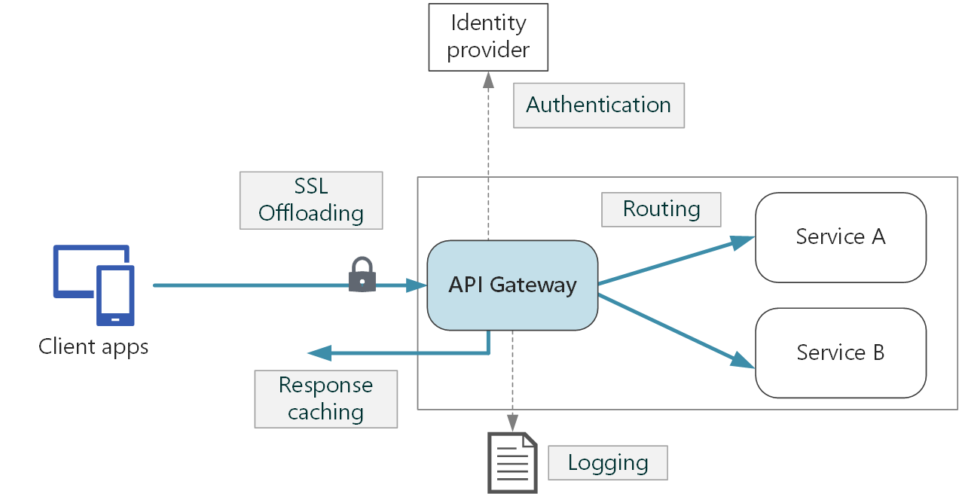
API Gateway
Source: docs.microsoft.com

Slide 10
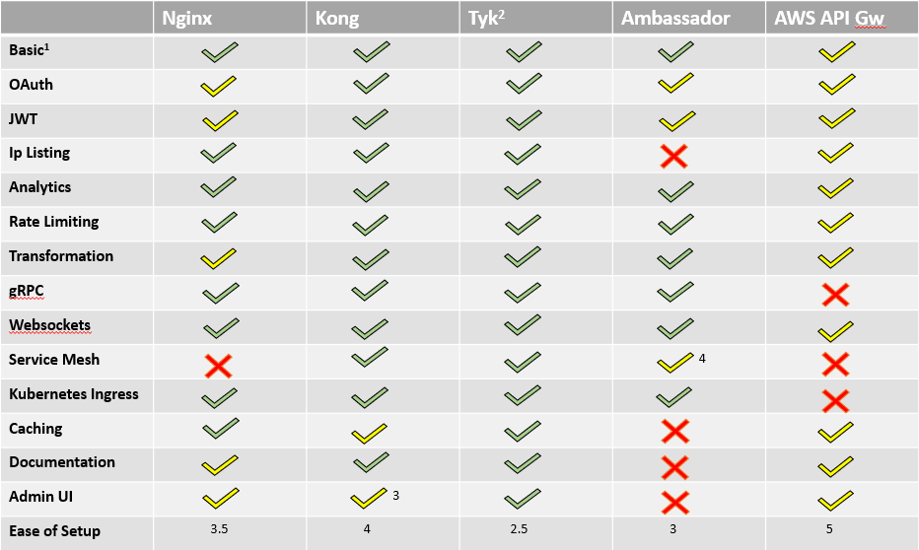
API Gateway
Source: medium.com/@mahesh.mahadevan

Slide 11
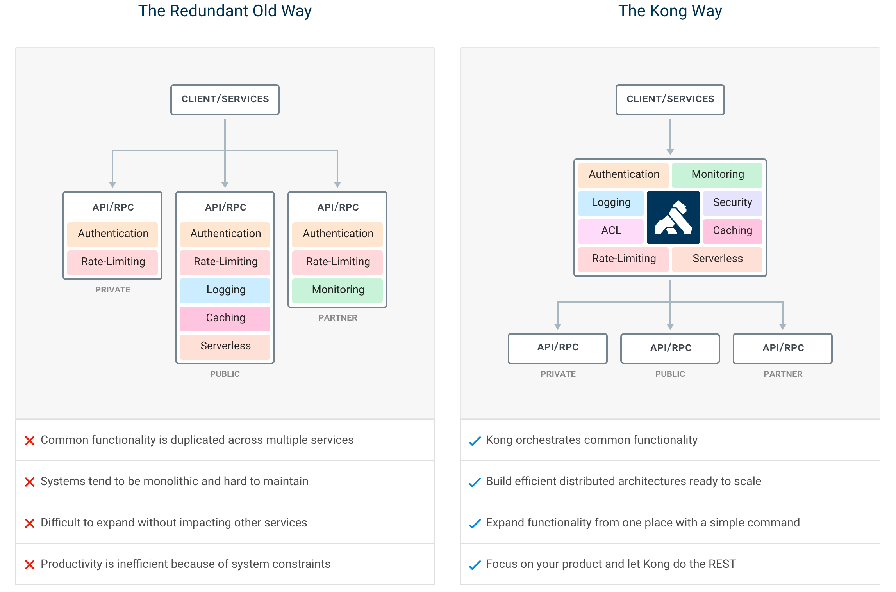
Kong Way
Source: medium.com/@far3ns/

Slide 12
Demo
jsonplaceholder.typicode.com
Docker
PostgreSQL
Kong
Konga
Authentication and Authorization

Slide 13
Integration Services
API-Driven Architecture
Event-Driven Architecture

Slide 14
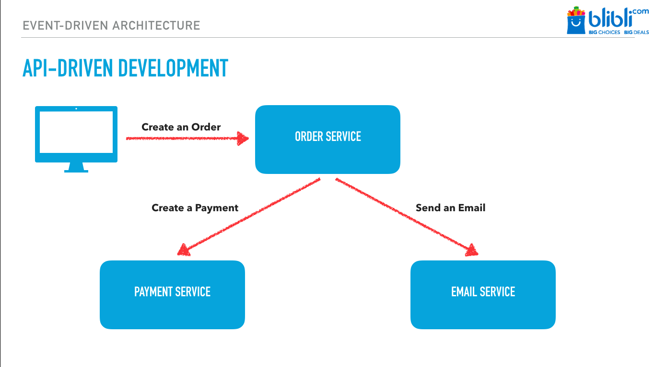
API-Driven Architecture
Source: medium.com/bliblidotcom-techblog

Slide 15
Others Microservice Challenge
10, 100, 1000, 100… request
Latency on response time at the service orchestrator/API gateway

Slide 16
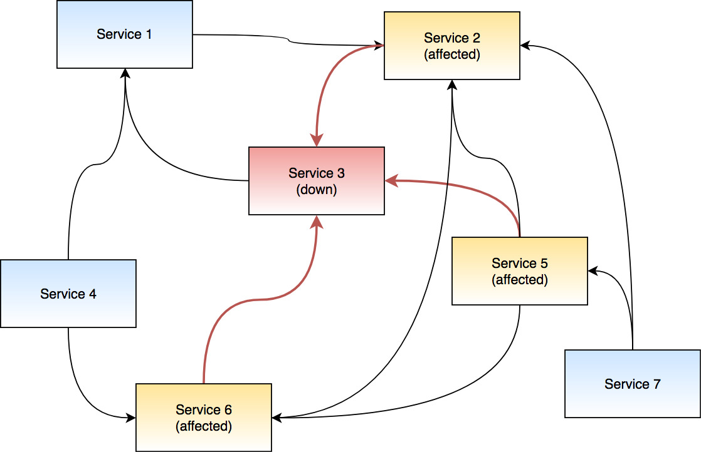

Slide 17
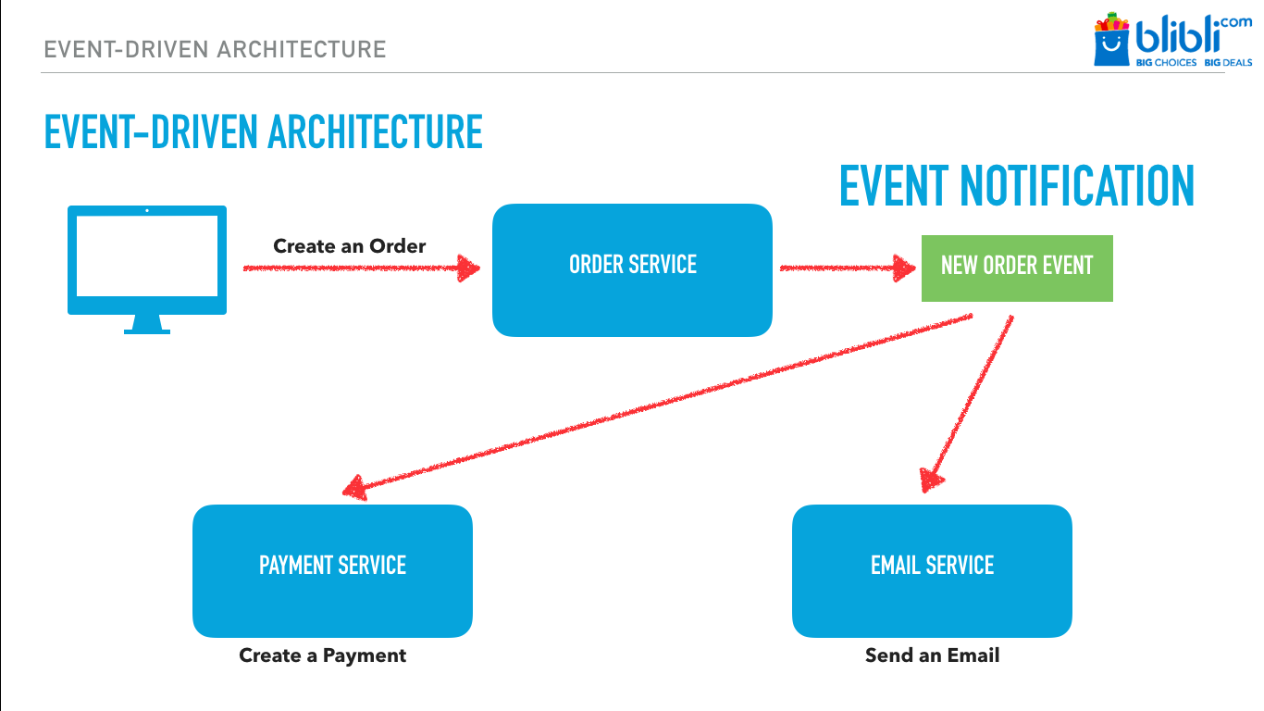
Event-Driven Architecture
Source: medium.com/bliblidotcom-techblog

Slide 18
Event Notification
Event notifications are sent to messages broker, such as Kafka, RabbitMQ, or ActiveMQ.
Messages broker at your Service.

Slide 19
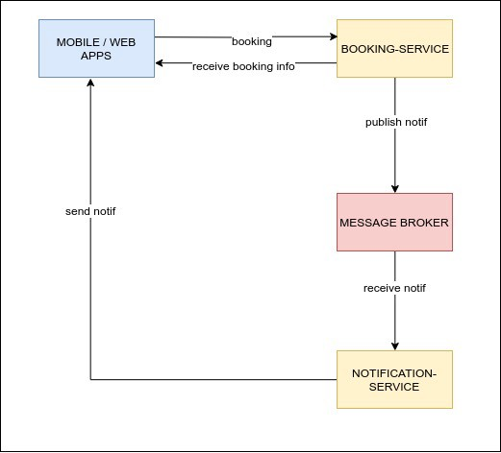
Source: medium.com/@acep.abdurohman90

Slide 20
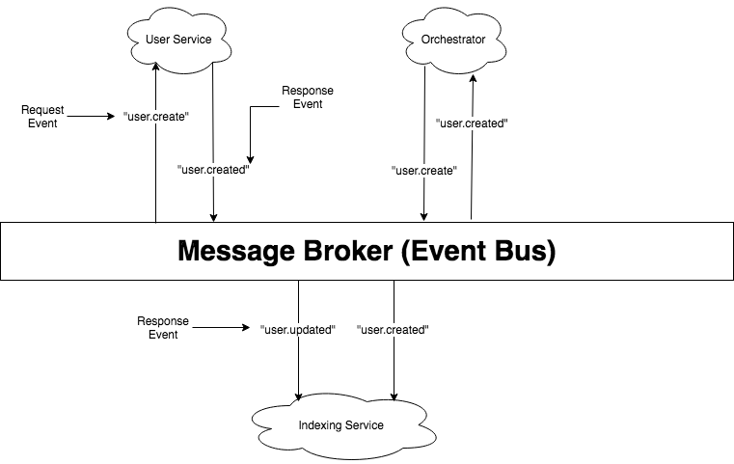
Source: medium.com/techmindtickle

Slide 21
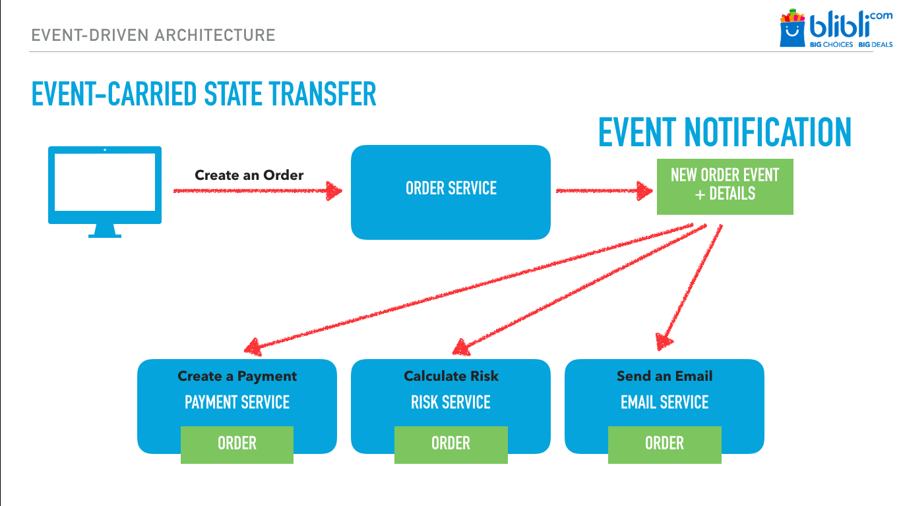
Source: medium.com/bliblidotcom-techblog

Slide 22
RabbitMQ
RabbitMQ is a message broker that implements Advanced Message Queuing Protocol(AMQP).
“STOP — LOOK — LISTEN — THINK”- RabbitMQ

Slide 23
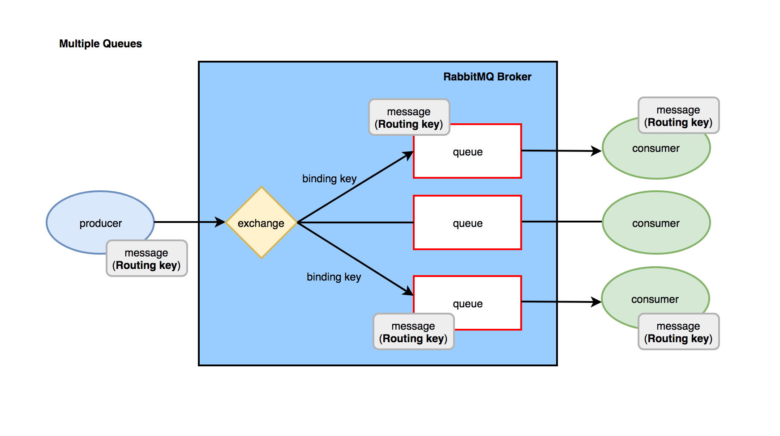

Slide 24
Thank You
Start Early, Start Small

